Slide 1


Breast Cancer Classification using CNN
Presented By: S.V.Vishal
Date: 01/10/2025

Slide 2

Abstract
Invasive Ductal Carcinoma (IDC) is the most prevalent and aggressive subtype of breast cancer which make women hard to recover even processed with certain medical surgeries.
Manual analysis of histopathological images is labor-intensive and subject to observer variability, creating the need for automated solutions.
This project addresses the challenge by implementing a Convolutional Neural Network (CNN)-based model for IDC breast cancer classification, utilizing pre-processed pathology images as input.
The proposed method employs transfer learning and robust data augmentation to enhance performance on limited medical datasets.
Our approach achieves high accuracy rates, with quantitative results reaching up to 96–98% on validation sets, outperforming baseline and conventional machine learning methods.

Slide 3
Outline
Introduction
Literature Reviews
Advancements and Challenges
Problem Statement
Data Collection and Pre-processing
Methodologies
Implementation
Discussion
Conclusion
References
Appendices

Slide 4
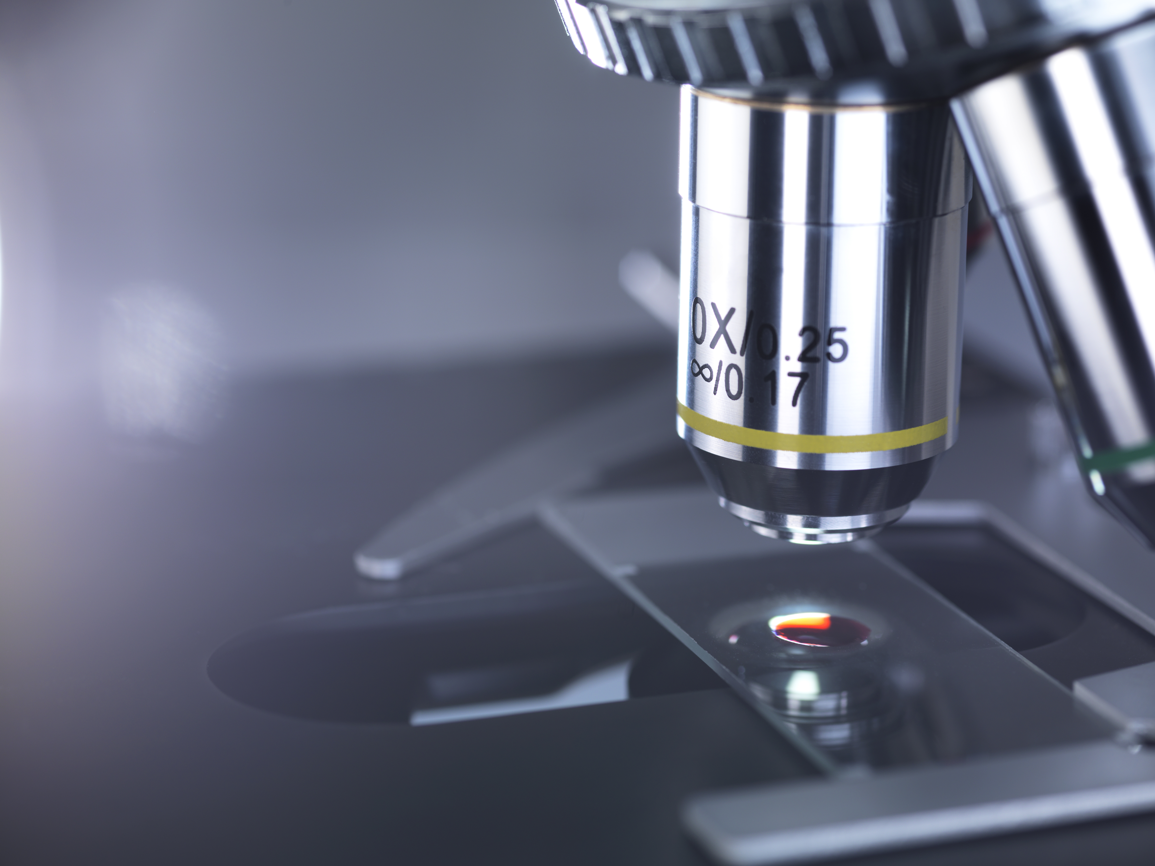
Section 1 Introduction

Slide 5
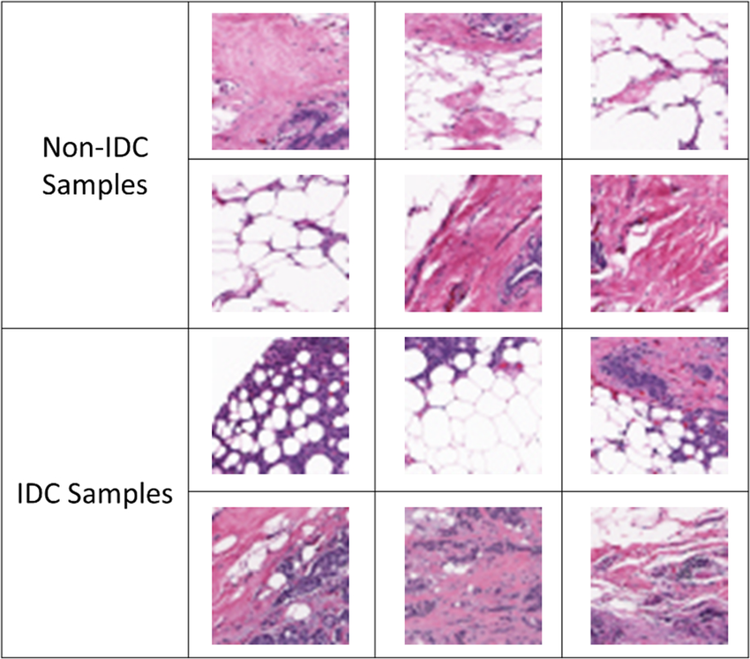
Introduction
Breast cancer is a life-threatening diseases affecting women globally. Invasive Ductal Carcinoma (IDC) is the most common subtype of breast cancer. Approximately 80% of all women diagnosed with breast cancer (According to America Cancer Society).
There are two types of changes based on breast tissue seen under microscope called as lesions-
Benign lesions(non-IDC): It is non-cancerous and do not invade surrounding tissue.
Malignant lesions(IDC): IDC belong to this type which show uncontrolled growth and invasion beyond the ducts into breast tissue.

Slide 6
Introduction – Summary
The objective of this project is to develop a ML classification system for IDC breast cancer using CNN. It analyses the provided images having cancer, distinguishes them whether that the image from the patient having IDC or not. Our goal is to provide accurate and rapid classifications of histopathology slides, thus supporting decision-making in clinical practice.
The methodology that we have used to extract patterns from histopathology images along with data cleaning, model selection, training, evaluation and interpretation of results which are done in this project.
This project also focused to contribute to diagnostic workflows, consistency and the AI-driven solutions used for medical image analysis.

Slide 7
Literature Reviews
CNNs revolutionized IDC classification in medical images by automatically learning key tissue features and outperforming traditional methods.
Recent Advances:
Transfer learning with pre-trained models (such as, ResNet, EfficientNet) has boosted accuracy (>95%).
Hybrid and ensemble architectures further improve robustness, generalization, and reliability.
Techniques like data augmentation and normalization address class imbalance and domain variability.
Challenges:
Lack of interpretability (black box problem) limiting clinical acceptance.
Performance may reduce due to image quality, restricted protocols, and limited data diversity.
Persistent issues with class imbalance and detection of rare malignant cases.
Ongoing research aims to improve model transparency, robustness, and seamless medical integration of AI-powered systems for IDC breast cancer classification.

Slide 8
Problem Statement
Traditional diagnosis of IDC heavily relies on labor-intensive and time-consuming image analysis may result into human error. As for this digital era, there is a critical need for an automated, accurate, and efficient method to classify IDC in breast tissue images along with the AI method (such as CNN).
This problem addresses a significant part in breast cancer diagnostics which aims to enhance accuracy and scalability through AI-driven solutions.
Limitations:
Potential domain variability due to differences in image staining and acquisition.
Class imbalance issues with fewer IDC samples.
CNN interpretability limitations may affect clinical acceptance.
Model performance depends on quality and representativeness of training data.

Slide 9
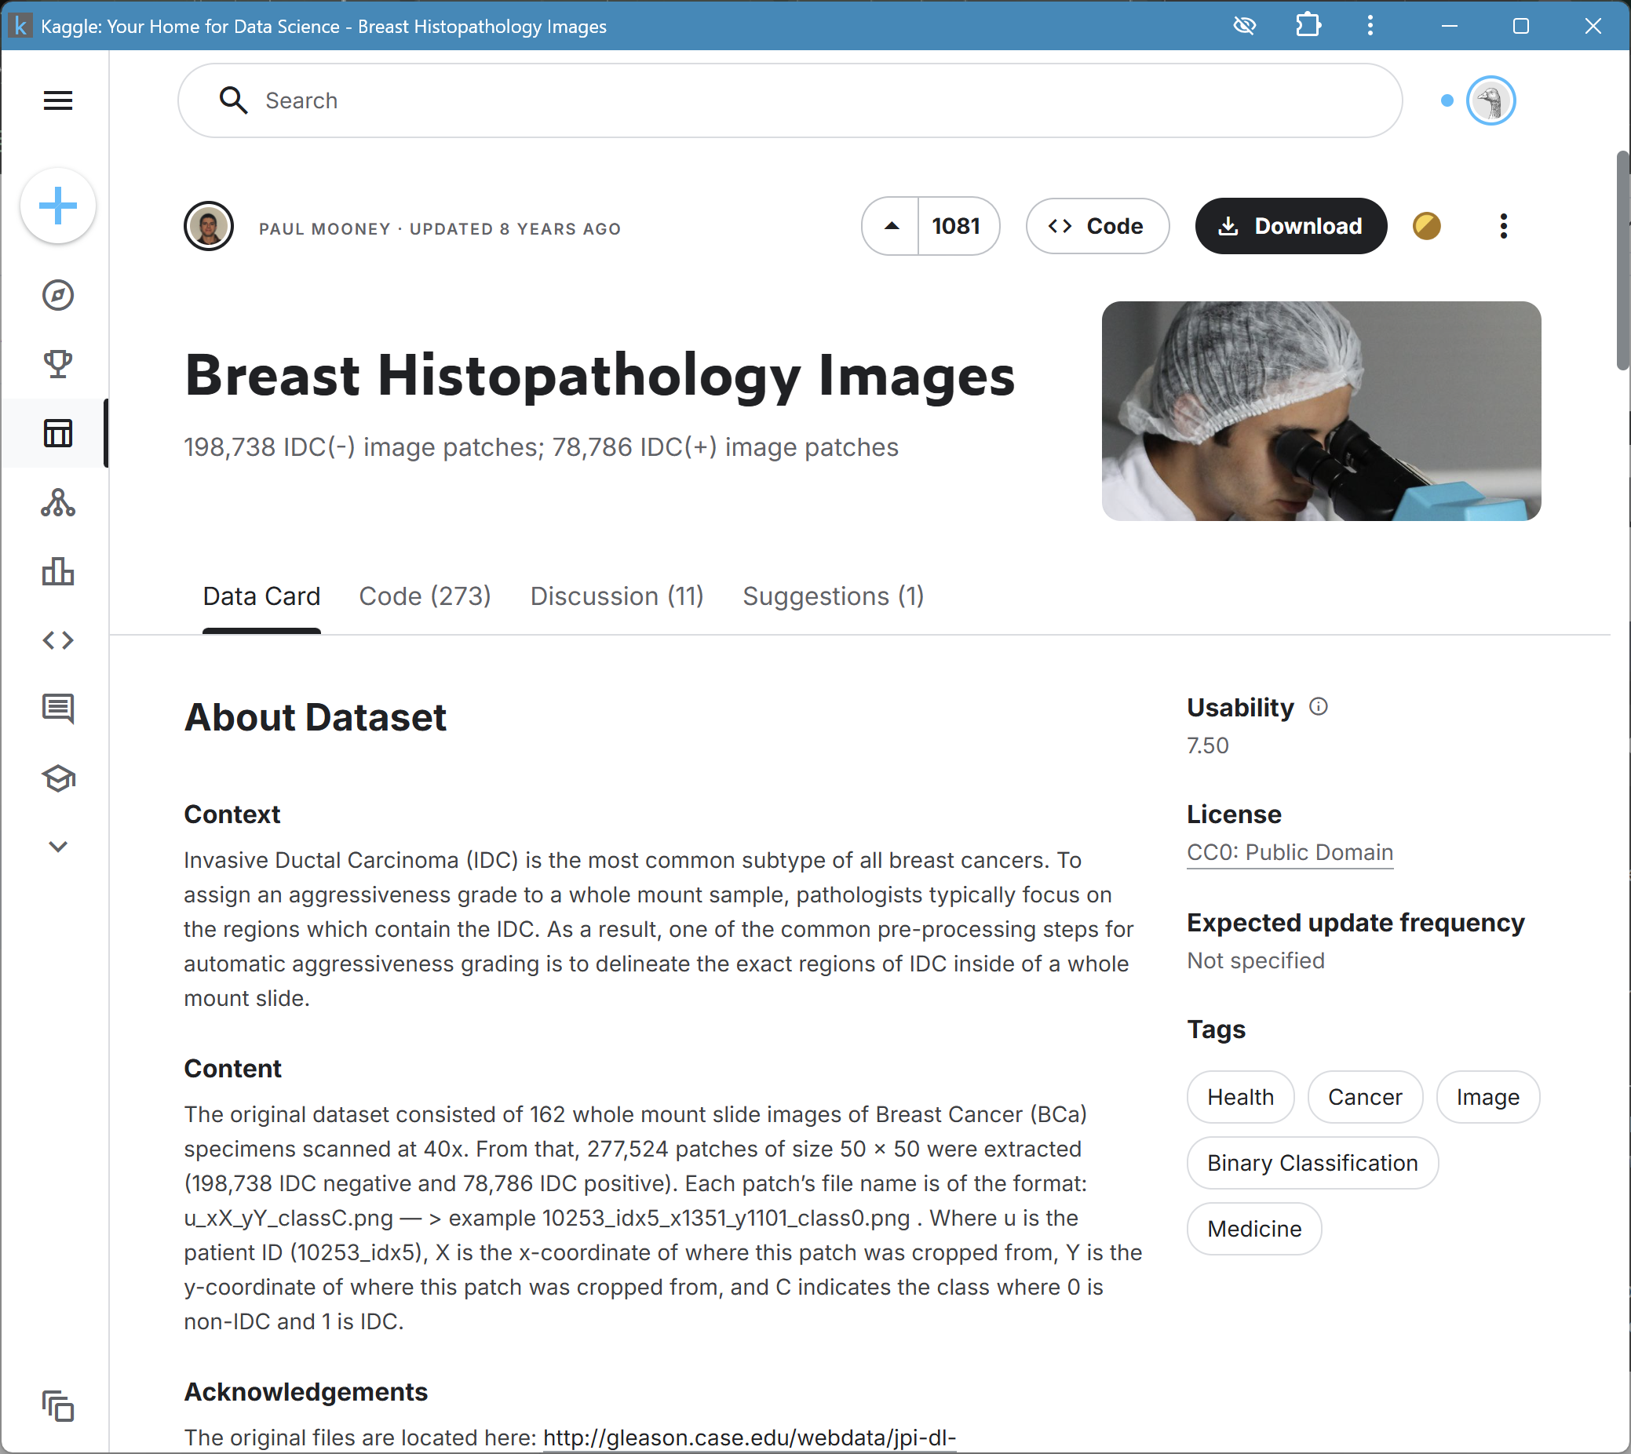
Data Collection and Pre-processing
I had used the data available in Kaggle. This dataset holds 2,77,524 patches of size 50×50 extracted from 162 whole mount slide images of breast cancer specimens scanned at 40x. Of these, 1,98,738 test negative(non-IDC) and 78,786 test positive with IDC. The dataset is available in public domain and you can download it. You’ll need a minimum of 3.02GB of disk space for this.
Dataset: IDC_regular dataset (the breast cancer histology image dataset)

Slide 10
Data Collection and Pre-processing
The steps that I had implemented before training the data are:
Resizing: All patches standardized to 50x50 pixels to ensure uniform input size for the CNN.
Normalization: Pixel values scaled to the range to stabilize network training.
Data Augmentation: Applied rotations (±40°), zoom, and brightness adjustments to increase dataset diversity, alleviate class imbalance, and reduce overfitting.
Train-Validation Split: Further ensured pre-division in the dataset and custom splits are used for additional validation.
The Image quality is consistent; labeled patches correctly represent IDC and non-IDC regions as 1’s and 0’s.

Slide 11
Methodologies
The technique that I had employed in my project is the Convolutional Neural Networks (CNNs) which excels in image recognition capabilities, to classify IDC from histopathological images.
Reason for implementation :
It can automate feature learning, removing the need for manual feature engineering.
Transfer learning from pre-trained models accelerates training and improves accuracy on limited medical datasets and improve performance.
Hybrid architectures capture both spatial and sequential tissue patterns, boosting robustness.
Parameter tuning (learning rate, batch size, dropout rate) using grid search and hyperparameter optimization methods(*) to identify the best combination for accuracy and generalization.
At the end, It achieved Classification accuracy typically above 80%, demonstrating the effectiveness of CNNs for IDC detection and grading, surpassing traditional ML methods.

Slide 12
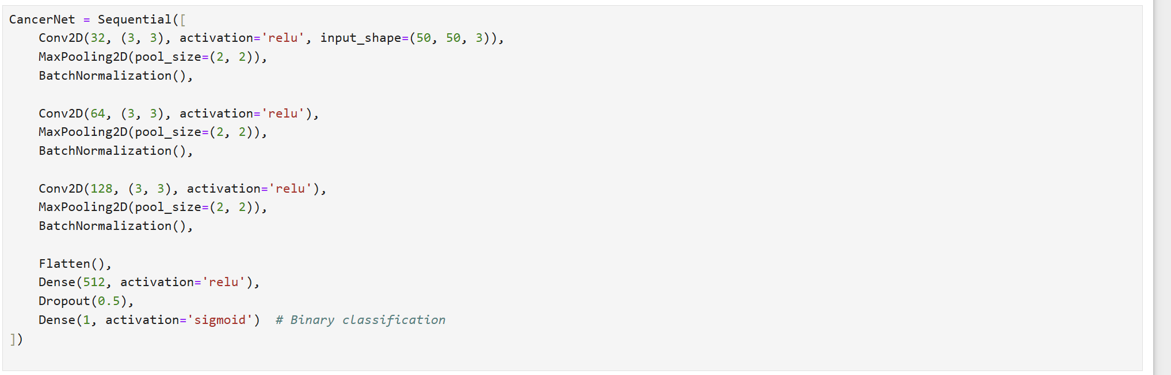
Implementation(github need)
The implementation of the IDC Breast Cancer Classification system using CNN follows a structured and reproducible pipeline designed for medical image analysis. Below is the outline of the steps involved:
Data Preparation
Model Selection and Architecture
Training Process
Evaluation
Deployment
GitHub :Breast Caner Classification

Slide 13
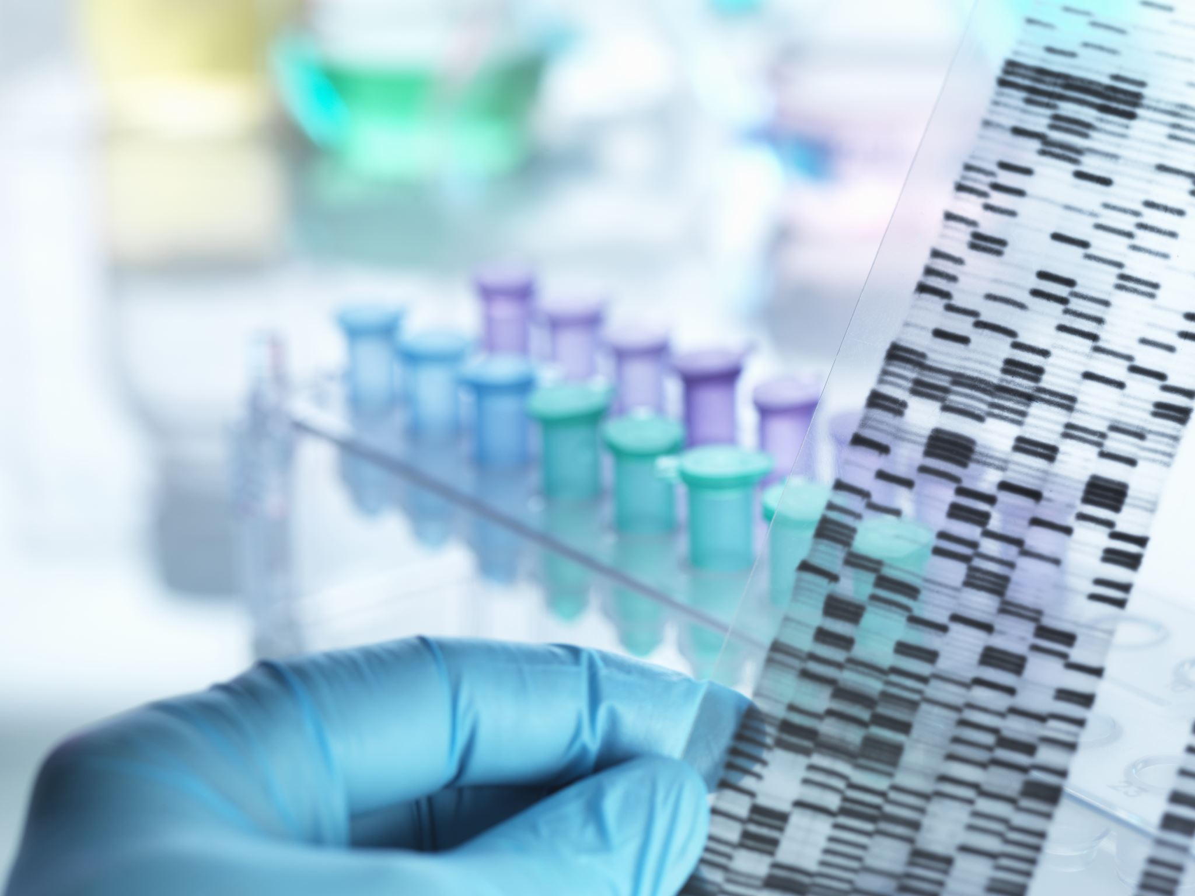
Section 2 Project Insights

Slide 14
Models | Dataset | Accuracy(%) | Precision(%) | Recall(%) | F1-Score(%)
Hybrid | BC-IDC | 96.3 | 93.4 | 86.4 | 89.7
ResNet | Multi-Grade | 91-92 | 94 | 92 | 92
Custom CNN (CancerNet) | Large histopath. image set (IDC) | 82.78 | 83 | 96 (Non-IDC) 50 (IDC) | 89 (Non-IDC) 62 (IDC)
Wavelet CNN | - | 98.4 | - | - | -
EfficientNetV2B0-21k | FBCG (4-class, cross-validation) | 96.7 | 96.5 | 96.7 | 96.4
Results
Quantitative Outcomes:
Recent research on IDC breast cancer classification using Convolutional Neural Networks (CNNs) demonstrates strong performance across a spectrum of models and methodologies. Here is a summary of quantitative results from state-of-the-art and comparative studies:

Slide 15
Results
Qualitative Outcomes
Interpretability: Most studies employ visualization (heatmaps, saliency maps) to show which tissue regions the CNNs use, supporting clinical credibility.
Generalization: Models validated on multiple datasets show high transferability, with accuracy often exceeding 90% on independent validation cohorts.
Clinical Relevance: Several studies report that their AI systems could reliably assist in reducing pathologist workload and subjectivity, especially in large-scale screening
Models/Approach | Accuracy (%)
CNN+EfficientNetV2B3 | 96.3
Customized CNN | 82.78
Wavelet CNN | 98.4
ResNet | 94

Slide 16
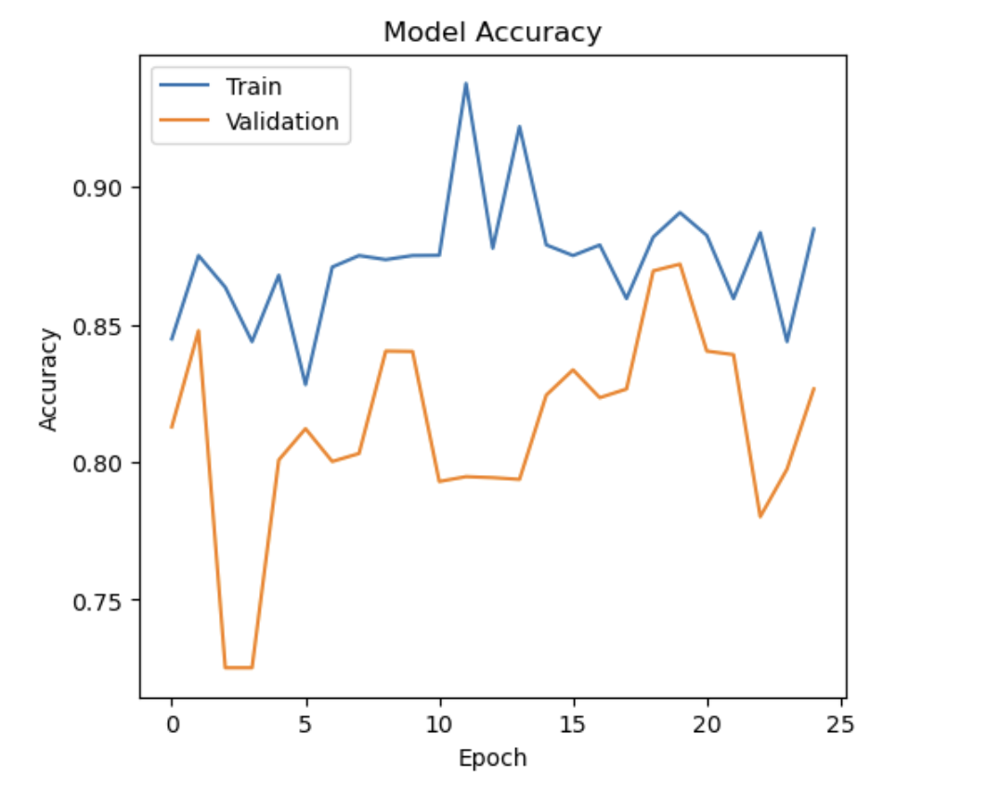
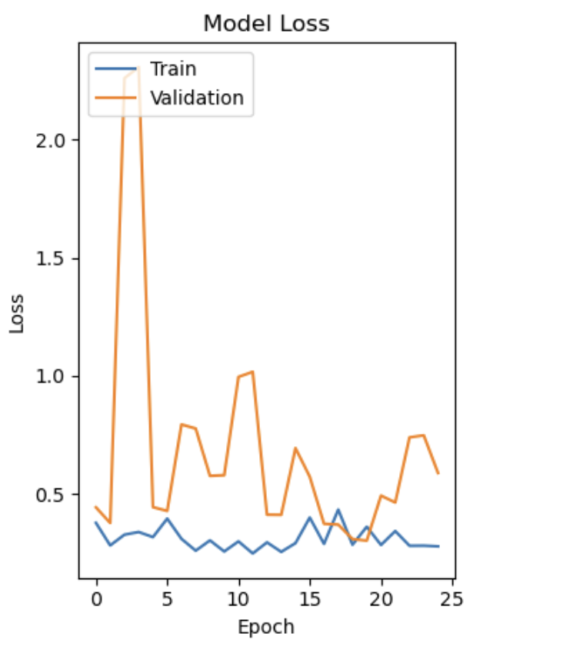
Results

Slide 17
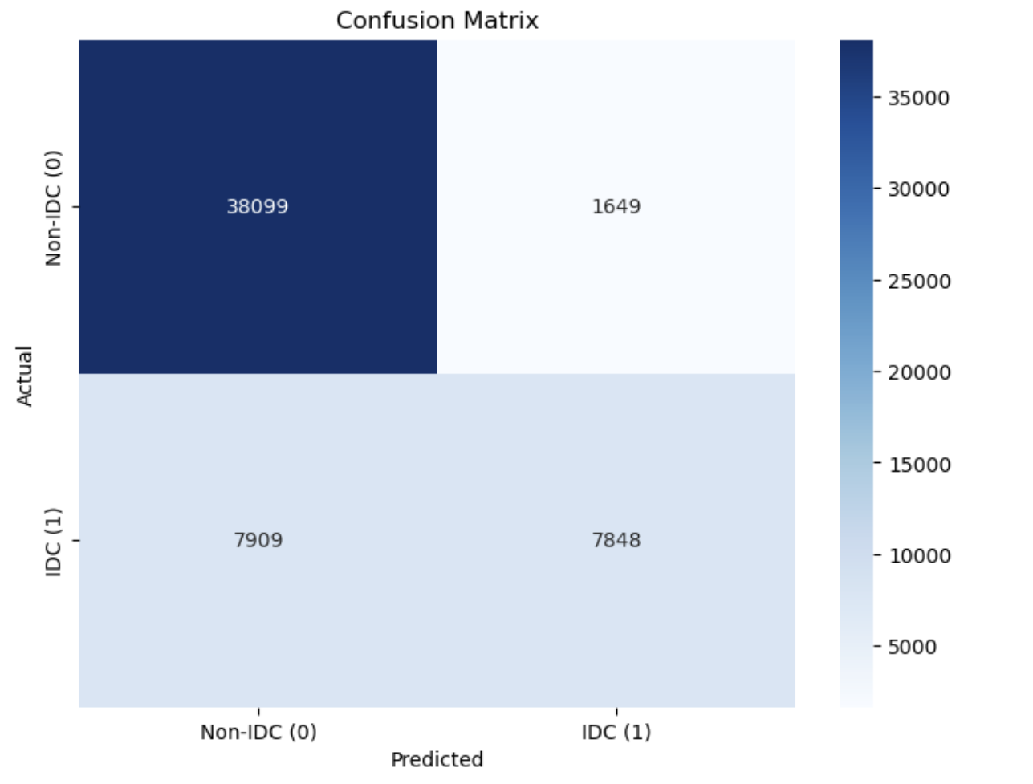
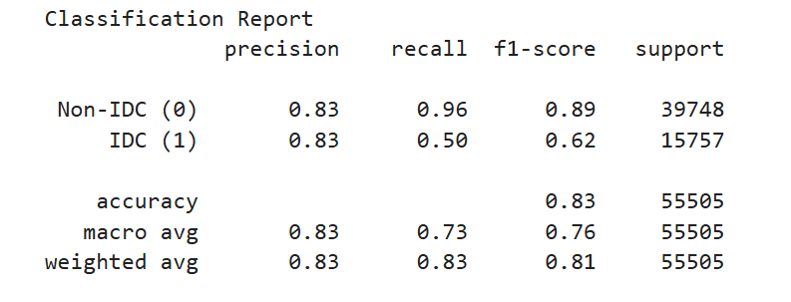
Results

Slide 18
Discussion
Interpretation of Results and Insights CNNs and hybrid models achieve 94–98% accuracy in IDC classification, outperforming traditional methods. Visualization techniques like heatmaps enhance trust by showing clinically relevant focus areas. Strong generalization suggests high potential for clinical adoption.
Unexpected Outcomes and Potential Implications ResNet show slightly lower recall, indicating issues with missed cancer cases. Balancing sensitivity and specificity remains a key research focus.
Strengths of the Approach CNNs and hybrid models deliver high diagnostic accuracy, scalability, and adaptability through transfer learning. Visualization improves interpretability, enhancing trust and decision-making. These AI systems can support faster and more consistent diagnoses.
Limitations Performance may drop due to data variability, domain shifts, and class imbalance. Despite visualization, full interpretability of CNN decisions remains difficult. Additionally, large models demand significant computational resources, limiting use in resource-constrained settings.

Slide 19
Conclusion
The use of CNNs for IDC breast cancer classification has led to major advancements in accuracy, speed, and interpretability.
Even if it provide robust performance and meaningful clinical support, challenges like data variability, interpretability, and real-world deployment addressed to fully realize the promise of AI in routine diagnostic workflows.
Future directions should prioritize model transparency, continual learning with new data, and integration into user-friendly clinical interfaces for maximum impact.
From now on, future researchers should focus on several key areas:
Improving Model Generalization
Enhancing Interpretability
Addressing Data Imbalance
Resource Optimization

Slide 20
References
dbzadnen/breast-histopathology-images. Hugging Face.
Publicly Available Datasets of Breast Histopathology H&E Whole Slide Images. PMC.
Performance analysis of seven Convolutional Neural Network architectures for breast cancer detection. Nature Scientific Reports.
CNN‐based deep learning approach for classification of invasive ductal and metastasis types of breast carcinoma. PMC.
Breast cancer classification based on hybrid CNN with LSTM model. Nature Scientific Reports.
A Magnification-Independent Method for Breast Cancer Classification Using CNN. ScienceDirect.
Automated detection and grading of Invasive Ductal Carcinoma using AI. ScienceDirect.
Breast Cancer Classification using Neural Networks. GitHub.

Slide 21
Appendices
Hardware/Software:
Hardware: Intel Core Ultra 155H with IGPU, 16GB RAM (or any better hardware like NVIDIA GPU for deep learning)
Framework: Python 3.8+, Jupyter Notebook, TensorFlow, NumPy, Scikit-learn, Matplotlib, Seaborn
Model Training:
Optimizer: Adam, learning rate = 0.0001
Batch Size: 32
Epochs: 50 (with early stopping)
Loss Function: Binary cross-entropy
Regularization: Dropout (0.5), Batch Normalization after each convolutional block

Slide 22

Thank You

